Slide 1
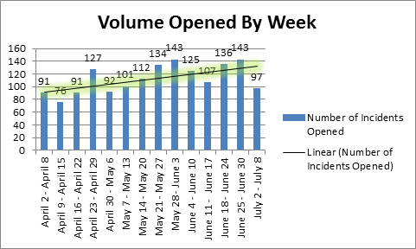
Microsoft Operations Support
The Challenge
Affirma was engaged by Microsoft Operations to hire the best talent for driving support cycle times down while handling a greater volume of support cases.
What We Did
In order to drive the support cycle times down, Affirma's team began layering metrics upon the analysts in addition to making these analysts aware that their performance was being monitored. Metrics tracking began the first week of April 2012.
Results
As a result of metric tracking, the analysts became more vigilant regarding their cases. This level of metric tracking combined with the analysts' behavioral shift resulted in a reduction of resolution times by 4.5 days, allowing the team to increase intake of new inquiries.
Tony Bussert developed several charts and dashboards to show these positive trends.

